Slide 1
Project Update – Week 3
Tora Gao, Zheng Shi, Leon Zhang

Slide 2
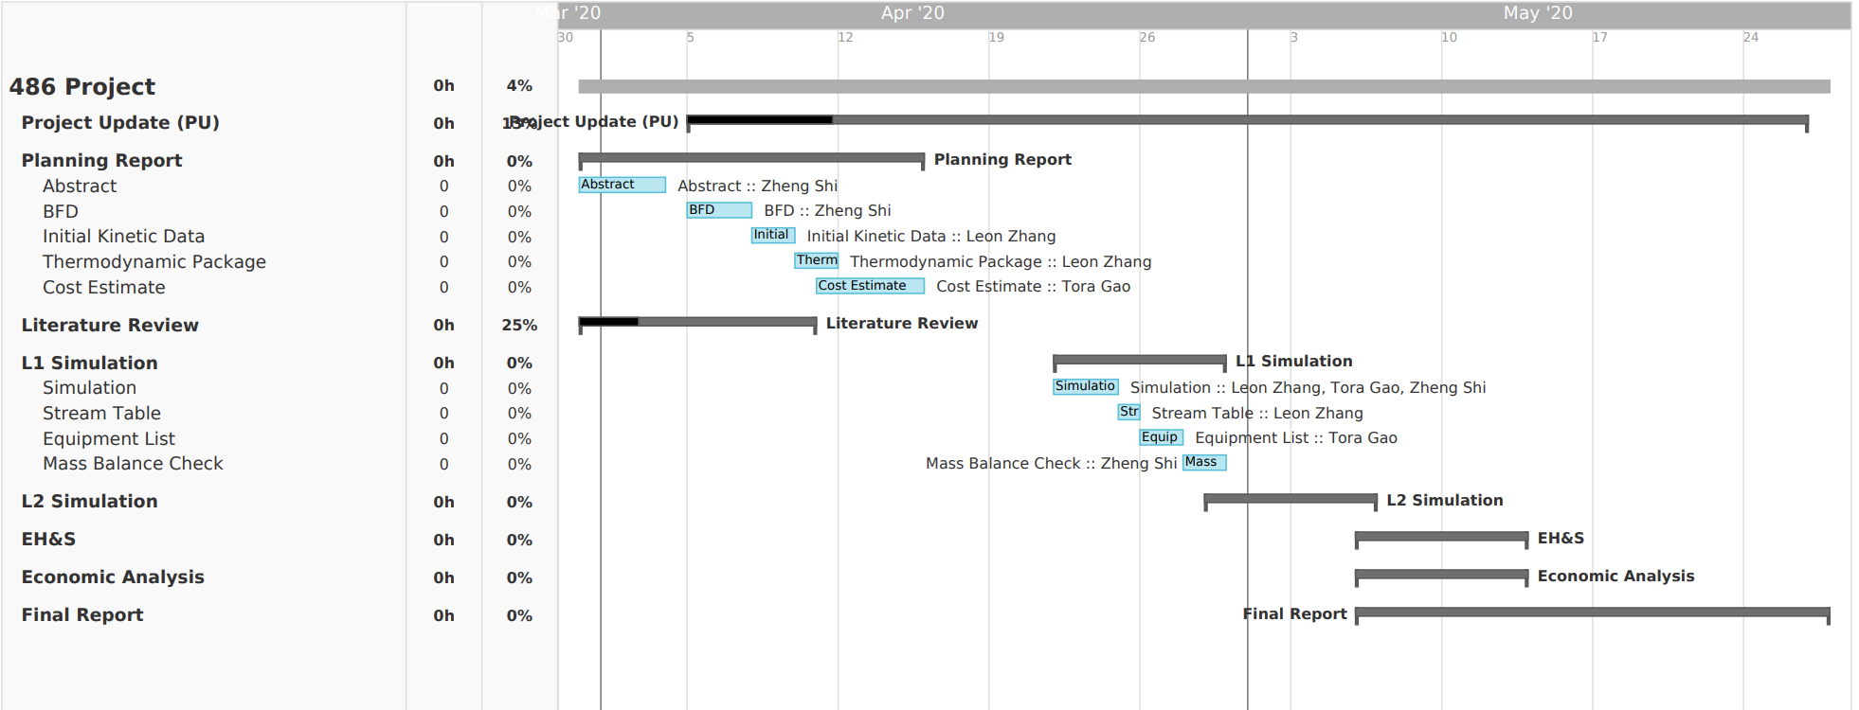
Gantt Chart
Notes:
https://prod.teamgantt.com/gantt/schedule/?ids=2115888#&ids=2115888&user=&custom=&company=&hide_completed=false&date_filter=&color_filter=

Slide 3






Tasks Completed
Findings for the upstream process
H2 Production
Electrolysis
N2 Production
Membrane
Cryogenic Distillation
Pressure Swing Absorption
Findings for the downstream process
NH3 Production
Small Scale Haber-Bosch
Non-Thermal Plasma Catalysis
Water Gas Shift Reaction
Literature Review
Planning Report
Abstract
BFD
Kinetics
Thermodynamics package
A lot of literature research!
Selected these processes for our project

Slide 4
Unexpected Hurdles and Potential Solutions
Hurdles:
Potential difficulty to simulate electrolysis process in Aspen
Difficulty of NTP
No industrial scale data
No references for scale-up and sizing
Very complex and very much still an academic thing
Slightly complex kinetics of Haber-Bosch reaction
Solutions:
Prof. Stuve can provide Excel sheet for electrolysis process of upstream
Use reliable numbers for purity/production/efficiency and just model using a stoichiometric reactor
Don’t use NTP – move forward with reactive-separation
Found kinetics for Haber-Bosch that can be modeled in ASPEN using Langmuir-Hinshelwood-Haougen-Watson (LHHW) form and RPlug reactor
Have already been able to implement kinetics in ASPEN (L2 reactor)

Slide 5
Short-Term and Long-Term Plans
Short-Term
Complete planning report and its components (Almost done)
Identify how to simulate each process component (specifically electrolysis, reactor, and N₂ production)
Complete L1 simulation
Long-Term
Determine viable simulation strategies for absorption, electrolysis, and pressure-swing adsorption
Move on to L2 simulation
Start thinking about economic analysis (emphasis on capital and operating costs)

